Slide 1
ARTIFICIAL INTELLIGENCE & MACHINE LEARNING
Calculus & Optimization: Convexity, Taylor expansion, Optimization objectives
Session – 14

Slide 2



AIM OF THE SESSION
To familiarize students with the basic concept of Convexity, Taylor expansion, and Optimization.
INSTRUCTIONAL OBJECTIVES
This Session is designed to:
Explain Convexity, Taylor expansion, and Optimization.
LEARNING OUTCOMES
At the end of this session, you should be able to:
Define the concepts of Convexity, Taylor expansion, and Optimization.

Slide 3
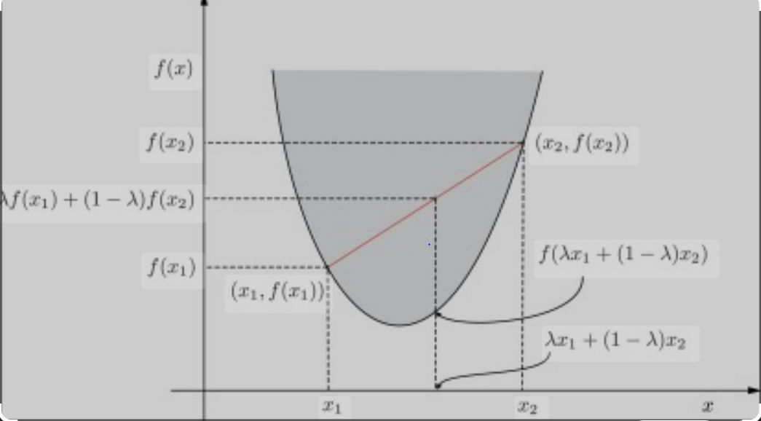
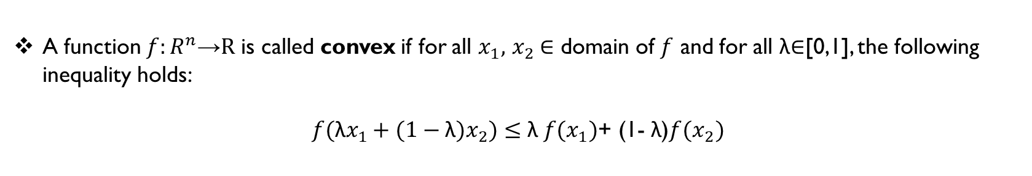
Convexity
A function $f:R^{n}\text{→}\text{R}$ is called convex if for all $x_{1},$ $x_{2}$∈ domain of $f$ and for all λ∈[0,1], the following inequality holds:
$f(\text{λ}x_{1}+(1−\text{λ})x_{2})≤$ $\text{λ} {f(x}_{1})$+ (1- $\text{λ}$)${f(x}_{2})$

Slide 4
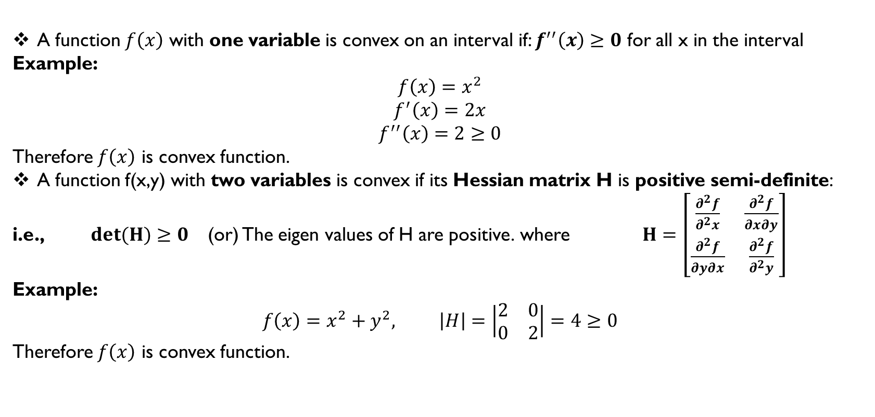
Conditions for Convexity
A function $f\left(x\right)$ with one variable is convex on an interval if: $f^{′′}\left(x\right)≥0$ for all x in the interval
Example:
$$f\left(x\right)=x^{2}$$
$$f^{′}\left(x\right)=2x$$
$$f^{′′}\left(x\right)=2≥0$$
Therefore $f\left(x\right)$ is convex function.
A function f(x,y) with two variables is convex if its Hessian matrix H is positive semi-definite:
i.e., $det(H)≥0$ (or) The eigen values of H are positive. where $H=\left[\begin{matrix}\frac{∂^{2}f}{∂^{2}x} & \frac{∂^{2}f}{∂x∂y} \\ \frac{∂^{2}f}{∂y∂x} & \frac{∂^{2}f}{∂^{2}y}\end{matrix}\right]$
Example:
$$f\left(x\right)=x^{2}+y^{2}, \left|H\right|=\left|\begin{matrix}2 & 0 \\ 0 & 2\end{matrix}\right|=4≥0$$
Therefore $f\left(x\right)$ is convex function.

Slide 5
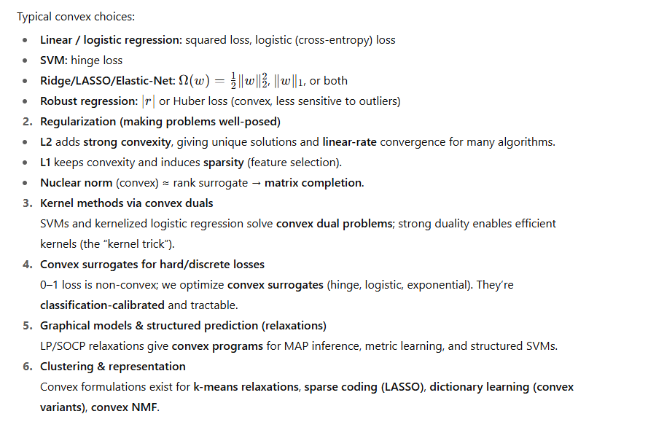
Convexity shows up all over ML because it makes training reliable, fast, and globally correct (when the whole objective is convex).

Slide 6
Convexity shows up all over ML because it makes training reliable, fast, and globally correct (when the whole objective is convex).

Slide 7
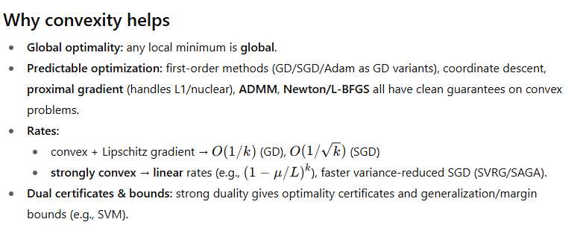

Slide 8
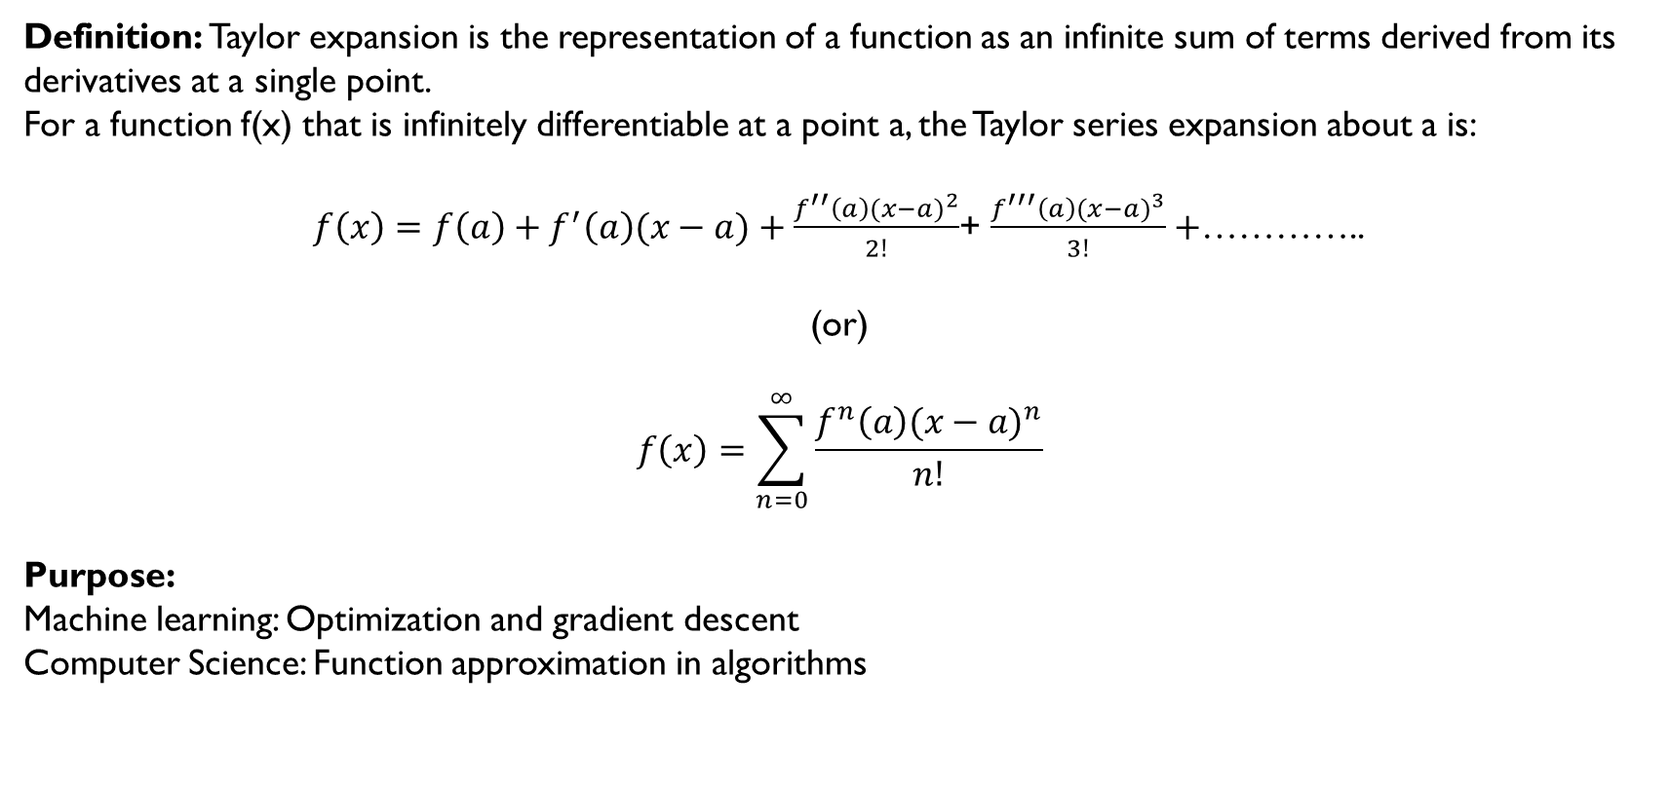
Taylor expansion
Definition: Taylor expansion is the representation of a function as an infinite sum of terms derived from its derivatives at a single point.
For a function f(x) that is infinitely differentiable at a point a, the Taylor series expansion about a is:
$f\left(x\right)=f\left(a\right)+f^{′}\left(a\right)(x−a)+\frac{f^{′′}\left(a\right){(x−a)}^{2}}{2!}$+ $\frac{f^{′′′}\left(a\right){(x−a)}^{3}}{3!}+$…………..
(or)
$$f\left(x\right)=\sum_{n=0}^{∞}{\frac{f^{n}\left(a\right){(x−a)}^{n}}{n!}}$$
Purpose:
Machine learning: Optimization and gradient descent
Computer Science: Function approximation in algorithms

Slide 9

Taylor expansion
Example-1: Taylor expansion of sin(x) about a=0
$f\left(x\right)=\sin\left(x\right), f^{′}\left(x\right)=\cos\left(x\right), f"(x)=−sin⁡(x),$…………….
$sin\left(x\right)=x−\frac{x^{3}}{3!}$+ $\frac{x^{5}}{5!}+$…………..
Approximation: $sin\left(x\right)=x−\frac{x^{3}}{6}$+ $\frac{x^{5}}{120}+$…………..
Example-2: Taylor expansion of $e^{x}$ about a=0
$$e^{x}=1+\frac{x}{1!}+\frac{x^{2}}{2!}+\frac{x^{3}}{3!}+…, −∞<x<∞$$
Purpose: Approximate complex functions with polynomials.

Slide 10
Optimization
The Optimization Problem is: Find values of the variables that minimize or maximize the objective function while satisfying the constraints.
Optimization problems consist of three basic components.
Objective function: Which we want to minimize or maximize
Variables: A set of unknown values that affect the value of the objective functions.
Constraints: A set of conditions that allow the variables to take on certain values but exclude others.

Slide 11
Optimization Objectives
Example:
A factory produces two products: A and B.
- Profit per unit A: $3
- Profit per unit B: $5
Each product requires labor and material:
- A: 1 hour labor, 2 units material
- B: 2 hours labor, 1 unit material
The factory has:
8 hours of labor available
6 units of material available
How many units of A and B should be produced to maximize profit?

Slide 12

Optimization Objectives
Formulation
Let:
x = number of units of product A
y = number of units of product B
1. Objective Function (to maximize profit):
$max z=3x+5y$
2. Variables: x, y
3. Subject to Constraints:
Labor: $x+2y≤8$
Material: $2x+y≤6$
Non-negativity: $x≥0, y≥0$

Slide 13
Reference Books:
1. Russel and Norvig, ‘Artificial Intelligence’, third edition, Pearson Education, PHI, (2015)
2. Elaine Rich & Kevin Knight, ‘Artificial Intelligence’, 3nd Edition, Tata Mc Graw Hill Edition, Reprint( 2008)
Sites and Web links:
https://www.virtusa.com/digital-themes/heuristic-search-techniques
https://towardsdatascience.com/a-star-a-search-algorithm-eb495fb156bb
https://www.tutorialandexample.com/local-search-algorithms-and-optimization-problem/
http://cgi.di.uoa.gr/~ys02/siteAI2008/local-search-2spp.pdf
http://aima.eecs.berkeley.edu/slides-pdf/chapter04b.pdf

